Slide 1
Introduction to Theory of Computation
Lecture 1
Rowaida AL-Amri

Slide 2
Syllabus
•introduction
Overview of course
• Alphabets, Strings, and Languages
• Set Relations and Operations
• Functions and Operations
• Graphs
• Boolean Logi

Slide 3
Why study the theory of computing?
Core mathematics of CS (has not changed in over 30 years)
Many applications, especially in design of compilers and programming languages
Important to be able to recognize incomputable and intractable problems
Need to know this in order to be a computer scientist, not simply a computer programmer

Slide 4
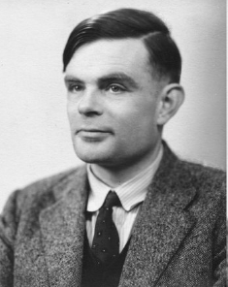
A pioneer of automata theory
Alan Turing (1912-1954)
Father of Modern Computer Science
English mathematician
Studied abstract machines called
Turing machines even before
computers existed

Slide 5
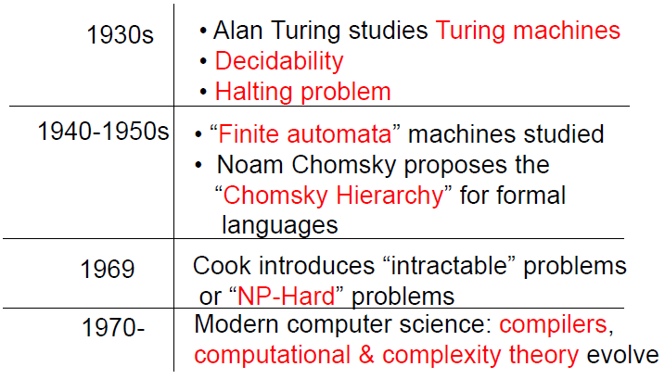
Theory of Computation: A
Historical Perspective

Slide 6
The Importance of Computational Theory in Computer Science
The importance of computational theory in computer science lies in the fact that it provides
1- It helps identify problems that can be solved by a computer and those that cannot be solved by algorithms.
2- It has contributed to the development of algorithms that consume less time and memory, thereby improving program performance.
3- It provides tools for measuring the complexity of algorithms in terms of time and space, which helps in selecting the most appropriate solutions.
4- It relies on concepts of formal languages and machines, which form the basis for the design of programming languages and compilers.
5- The ability to analyze problems and formulate precise solutions using mathematical models and algorithms.

Slide 7
Definition
The theory of computation is the branch of computer science that deals with whether and how efficiently problems can be solved on a model of computation, using an algorithm.
Computational theory aims to answer questions such as:
- What problems can a computer solve?
- What is the fastest way to solve a given problem?
- Are there problems that are impossible for a computer to solve, no matter how powerful it is?

Slide 8
Introduction
The field is divided into three major branches:
- Automata Theory (Formal Languages & Automata ): studies simple models of computing, such as: Finite Automata and Regular Expression Used in Compilers What is a computer?
- Computability theory: studies which problems are computationally solvable using computers such as Turing Machine : What can and cannot be computed?
- Complexity theory: deals with the question of how efficiently a problem can be solved, rather than whether it is solvable at all. What can and cannot be computed efficiently

Slide 9
Theory of Computation
Computational Complexity
Computability Theory
Formal Languages & Automata
Time Complexity
Space Complexity
Turing Machine
Halting Problem
Regular Languages
Regular Expression
Finite Automata
P,NP, NP-Complete
Decidable Problems)
Undecidable Problems)

Slide 10
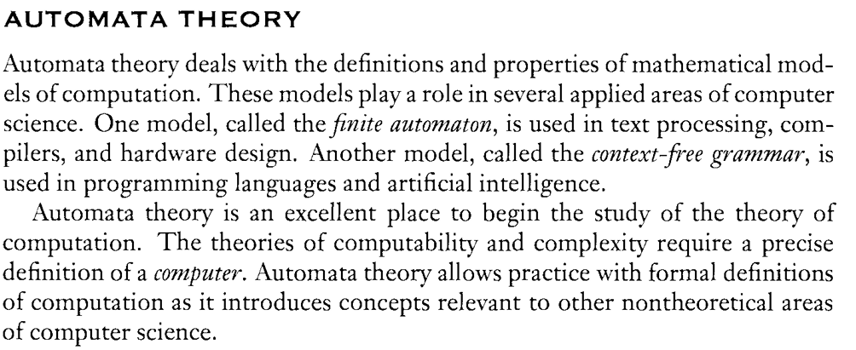
Automata Theory

Slide 11
Computability Theory
• There are algorithms to solve many problems.
• But there are some problems for which there is no algorithm.
• These are called undecidable problems:
- Does a program run forever?
- Is a program correct?
- Are two programs equivalent

Slide 12
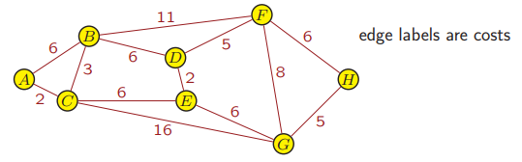
Complexity Theory
For problems that are solvable, how long does it take for an algorithm to solve a problem?
• Some problems can be solved efficiently:
Is there a path from A to H with total cost at most 20
• Some problems have no known efficient algorithm:
Is there a path from A to H with total cost at least 50?

Slide 13
Basic Concepts
- Alphabet: A finite set of symbols, such as Σ = {0,1}.
Symbol: A single element of the alphabet.
- String/Word: A sequence of symbols.
Empty String: Denoted by ε.
String length: Denoted by |w|.
language: as a set of strings composed of alphabet symbols
Operations on strings and languages
Concatenation.
Power (e.g., Σ², Σ³).
Kleene Star, denoted by Σ*.
Kleene Plus, denoted by Σ⁺

Slide 14
alphabet
An alphabet is a finite set of fundamental units (called letters or symbols).
  Notation: Σ
  We typically denote an alphabet by a capital Greek letter • e.g., Σ or Γ.
Examples:
• The alphabet of lower-case Roman letters is Σ= { a, b, c,..., z }.
• The alphabet of upper-case Roman letters is Γ= {A, B, C,..., Z }.
• The alphabet of Arabic numerals is Σ= { 0, 1, 2,..., 9 }.
Binary alphabet : Σ= {0, 1}.

Slide 15
Strings
Definition: A string over an alphabet is a finite sequence of symbols from the alphabet (written without commas or spaces between the symbols).
Examples:
• cat, food, c, and babbz are strings over the alphabet
Σ= {a, b, c, . . . , z}.
• 0131 is a string over the alphabet Σ= {0, 1, 2,..., 9}.
0000 is a string over the binary alphabet

Slide 16
Strings
- For any string s, the length of s is the number of symbols in s.
Sometimes denote length of s by length(s) or |s|.
Example: length(mom)= |mom| =3.
- The empty string or null string, denoted by ε, is the string consisting of no symbols,
|ε| =0.

Slide 17
Strings
Kleene Star: For a given alphabet Σ, let Σ∗ denote the set of all possible strings (including ε) over Σ.
Example: If Σ= {a, b}, then
Σ∗ = { ε, a, b, aa, ab, ba, bb, aaa, aab, aba, abb, . . . }.
Lexicographic Order: A list of strings w1,w2,... over an alphabet Σ is in lexicographic order if
1. shorter strings always appear before longer strings, and
2. strings of the same length appear in alphabetical order.
Example: If Σ= {0, 1}, the lexicographic ordering of the strings in
Σ∗ is ε, 0, 1, 00, 01, 10, 11, 000, 001, 010, 011, ...

Slide 18
Strings
Concatenation : Given two strings u and v, we define the concatenation of u and v to be the string uv.
Examples:
• If u = abb and v = ab, then uv = abbab and vu = ababb.
• If u = ε and v = ab, then uv = ab.
• If u = bb and v = ε, then uv = bb.
• If u = ε and v = ε, then uv = ε; i.e., εε = ε.

Slide 19
Strings
Concatenation : For string w, we define w^{n} for n ≥ 0 inductively as follows:
• w⁰ = ε;
• w^{n} = w^{n−1}w for any n ≥ 1.
Example: If w = dog, then
w0 = ε,
w1 = w⁰w = εdog = dog,
w2 = w¹w = dogdog,
w3 = w²w = dogdogdog,
. Example: Can also apply this to a single symbol
• a³ = aaa
• a⁰ = ε.

Slide 20
Strings
Substring :given a string s,a substring of s is any contiguous part of string s.
• i.e., w is a substring of s if there exist strings x and y (either or both possibly empty) such that s = xwy.
Examples:
• w = 47 is a substring of s = 472 since letting x = ε and y =2
gives s = xwy.
• The string 472 has substrings ε, 4, 7, 2, 47, 72, and 472.
• 42 is not a substring of 472.

Slide 21
Binary operations on strings
2. Prefix - u is a prefix of v if there is a w such that v = uw.
  Examples:
    ε is a prefix of 0 since 0 = ε0
    apple is a prefix of appleton since appleton = apple.ton
3. Suffix - u is a suffix of v if there is a w such that v = wu.
  Examples:
    0 is a suffix of 0 since 0 = ?
    ton is a suffix of appleton since ?

Slide 22
Languages
A formal language (or simply language) is a set of strings over an alphabet.
• Language will typically be denoted by capital Roman letter, e.g., A, B, or L.
Examples:
• Computer languages, e.g., C or C++ or Java, are formal languages with alphabet
Σ= {a, b,..., z, A, B,..., Z,, 0, 1, 2,..., 9, ,
>, <, =, +, -, *, /, (, ), ., ,, &, !, %, |, ’, ",
: , ; , ˆ , {, }, @, #, \, ?, $, ~, ‘, CR, FF}.
The rules of syntax define the rules for the language.

Slide 23
Languages
Example: Alphabet Σ= {x}.
Language L0 = { ε, x, xx, xxx, xxxx, . . . }
= { x^{n} | n =0, 1, 2, 3 ... }
Note that
• x⁰ = ε, so ε ∈ L0.
• there are different ways we can specify a language.
Another language
L1 = { x^{n} | n ≥ 1 }
has ε ∈ L1.

Slide 24
Languages
Example: Alphabet Σ= {x}.
Language L2 = { x, xxx, xxxxx, xxxxxxx, . . . }
= { x^{2n+1} | n =0, 1, 2, 3,... }
Example: Alphabet Σ= {0, 1, 2,..., 9}.
Language L3 = { any string of symbols that does not start with symbol “0”}
= { ε, 1, 2, 3, ..., 9, 10, 11,... }
Example: : Let Σ= {a, b}, and we can define a language L consisting of all strings that begin with a followed by zero or more b’s; i.e.,
L = { a, ab, abb, abbb, . . . }
= { ab^{n} | n =0, 1, 2,... }.

Slide 25
Languages
Empty language : empty set of string( is the set consisting of no elements.)
- ε ∈∅ since ∅ has no elements.
- ∅ = { ε } since ∅ has no elements.
Language over alphabet Σ - a set of strings over Σ.
  Notation: L.
  Examples:
    {0, 00, 000, ...} is an "infinite" language over the binary alphabet.
    {a, b, c} is a "finite" language over the English alphabet.

Slide 26
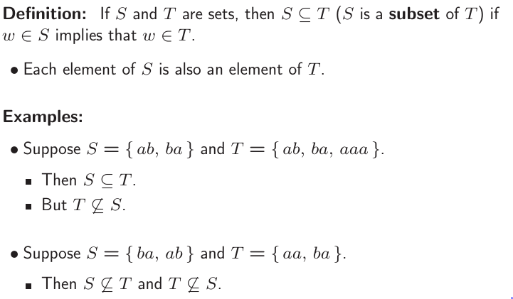
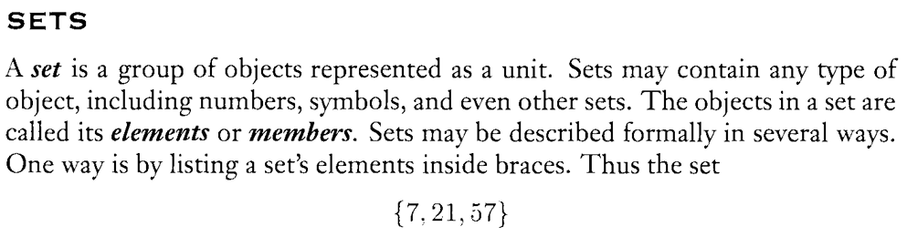
Set Relations and Operations

Slide 27
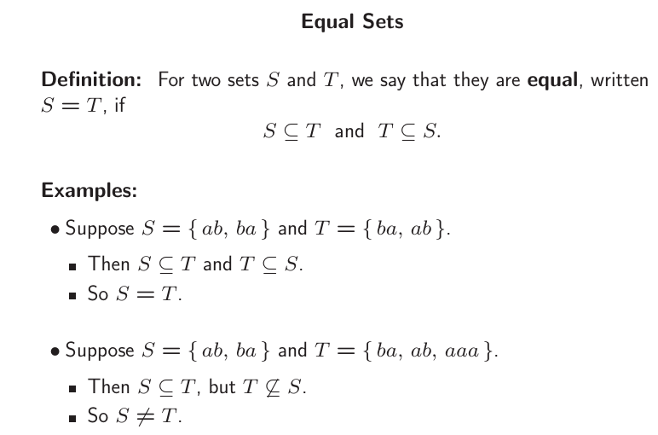

Slide 28
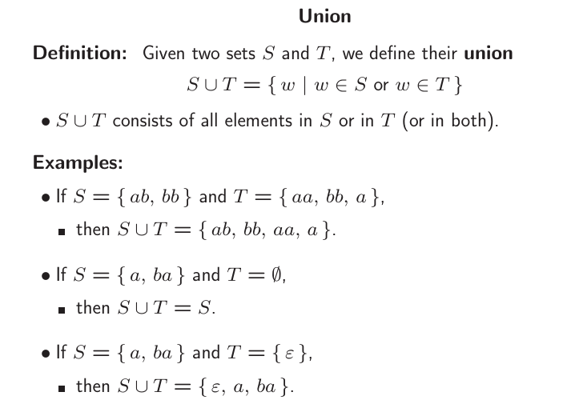

Slide 29
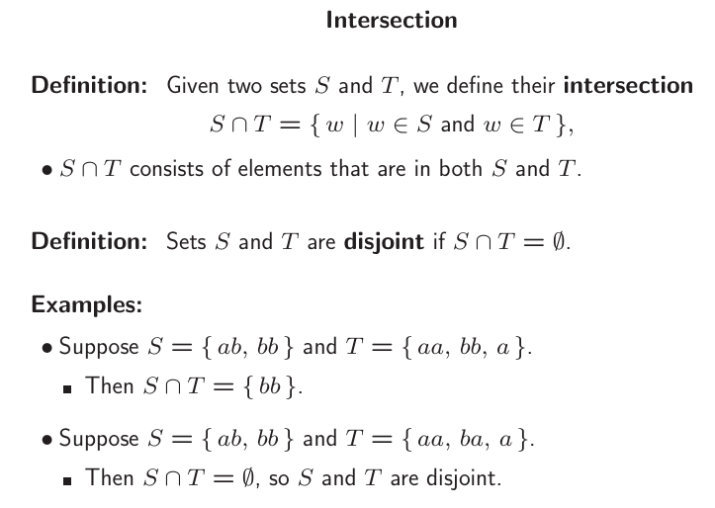

Slide 30
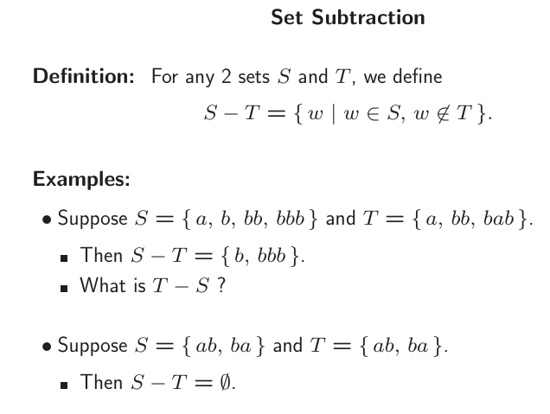

Slide 31
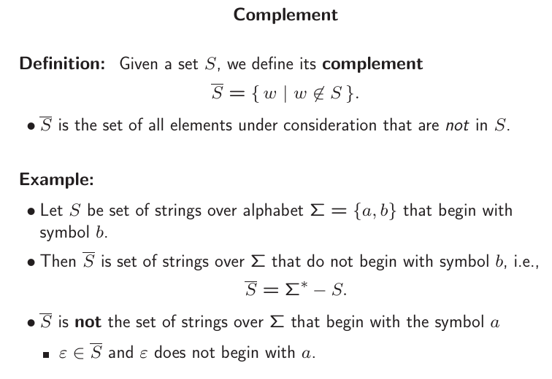

Slide 32
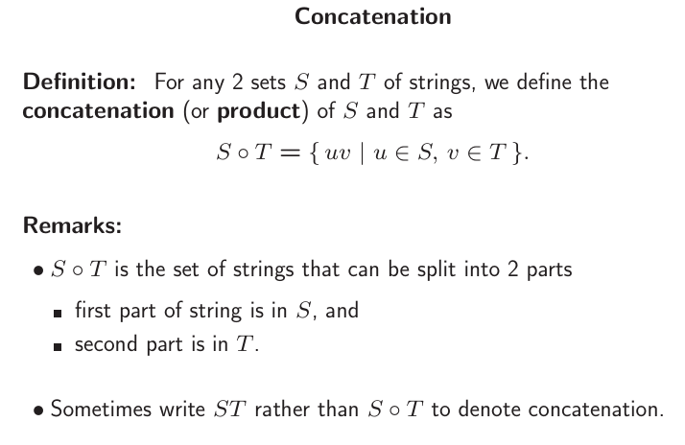

Slide 33
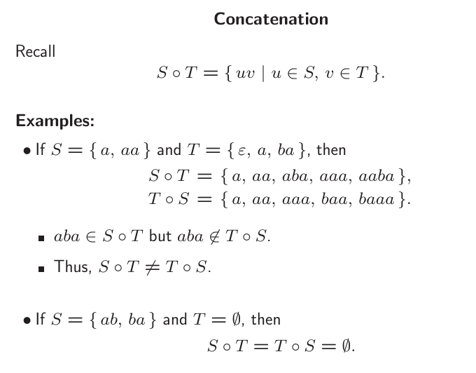

Slide 34
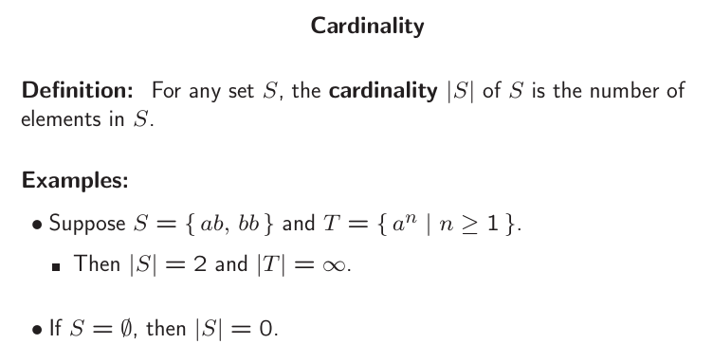

Slide 35
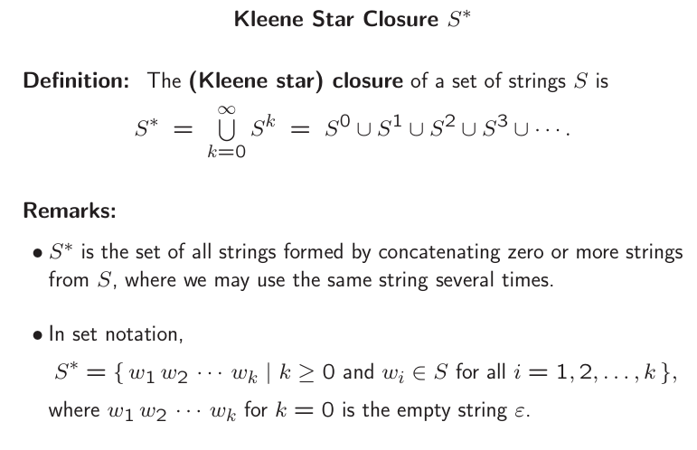

Slide 36
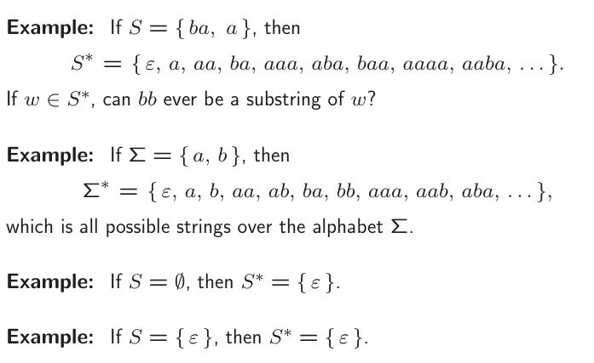

Slide 37
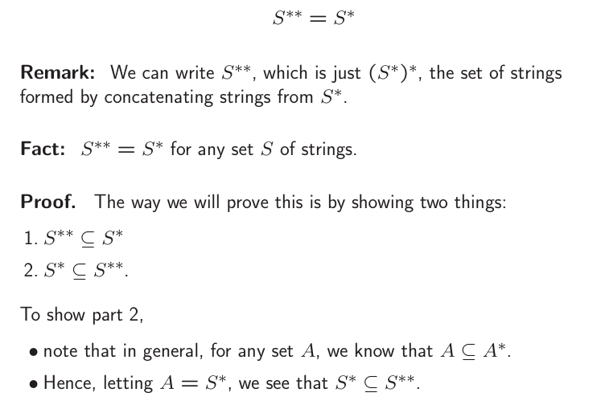

Slide 38
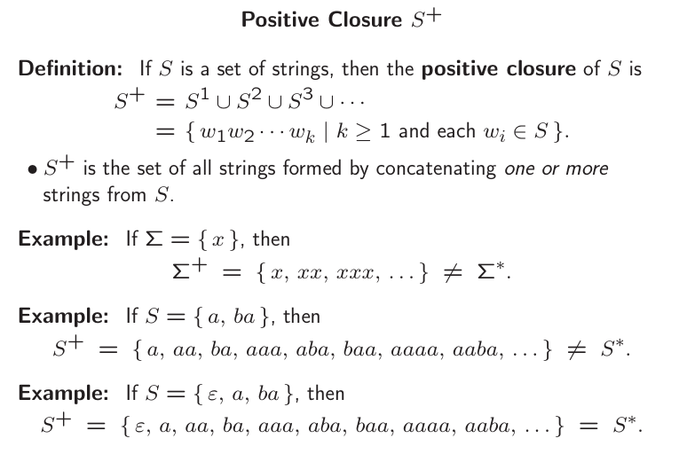

Slide 39
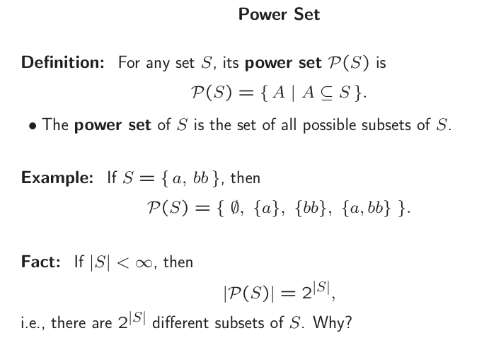

Slide 40
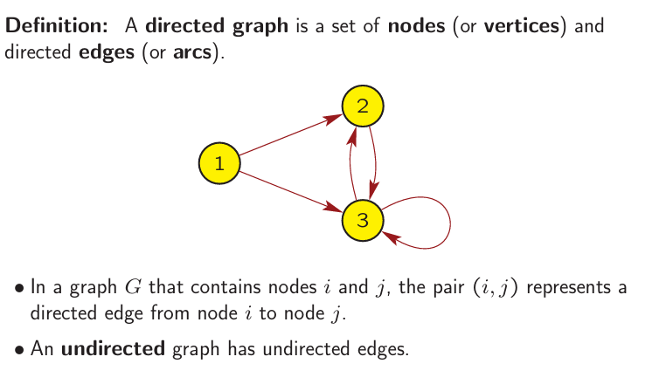
Graphs

Slide 41
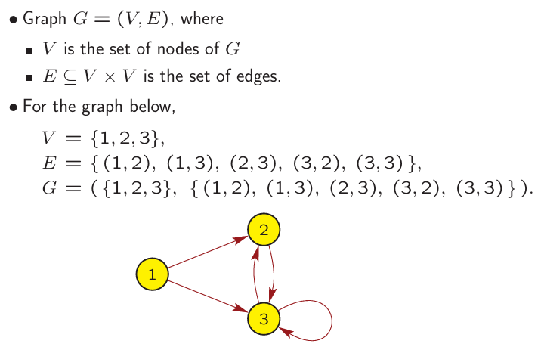
Example of Directed Graph

Slide 42
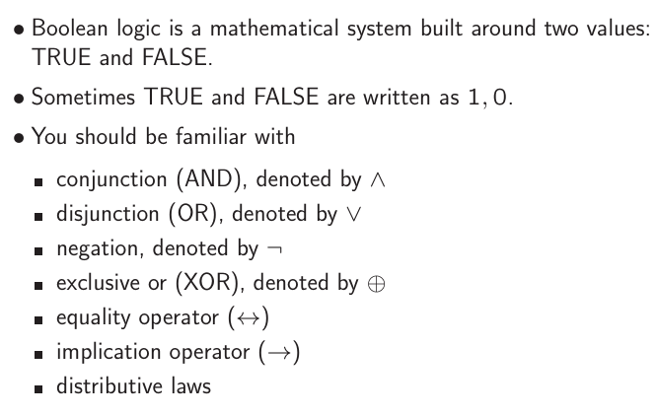
Boolean Logic

Slide 43
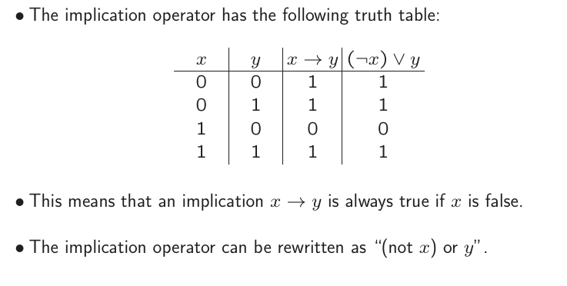
Some Properties of Boolean Logic

